Slide 1
Data Visualization

Slide 2
Types of Charts to Use for Your Data
Column Chart
Bar Graph
Line Graph
Dual Axis Chart
Area Chart
Stacked Bar Graph
Mekko Chart
Pie Chart
Scatter Plot Chart
Bubble Chart
Waterfall Chart
Funnel Chart
Bullet Chart
Heat Map

Slide 3
5 Questions to Ask When Deciding Which Type of Chart to Use
Want to compare values?
Want to show the composition of something?
Want to understand the distribution of your data?
Interested in analyzing trends in your data set?
Want to better understand the relationship between value sets?

Slide 4
1: Want to compare values:
Charts are perfect for comparing one or many value sets, and they can easily show the low and high values in the data sets. To create a comparison chart, use these types of graphs:
Column
Mekko
Bar
Pie
Line
Scatter Plot
Bullet

Slide 5
2: Want to show the composition of something?
Use this type of chart to show how individual parts make up the whole of something, such as the device type used for mobile visitors to your website or total sales broken down by sales rep.
Pie
Stacked Bar
Mekko
Stacked Column
Area
Waterfall

Slide 6
3: Want to understand the distribution of your data?
Distribution charts help you to understand outliers, the normal tendency, and the range of information in your values.
Scatter Plot
Mekko
Line
Column
Histogram

Slide 7
4:Interested in analyzing trends in your data set?
If you want to know more information about how a data set performed during a specific time period, there are specific chart types that do extremely well.
Line
Dual-Axis Line
Column

Slide 8
5: want to better understand the relationship between value sets?
Relationship charts are suited to showing how one variable relates to one or numerous different variables. You could use this to show how something positively effects, has no effect, or negatively effects another variable.
Scatter Plot
Bubble
Line

Slide 9
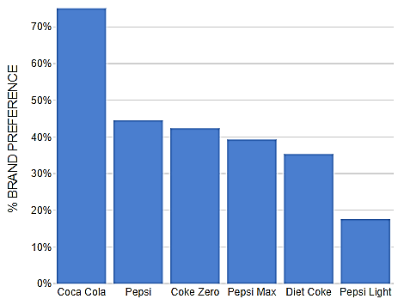
Column Chart:
A column chart is used to show a comparison among different items, or it can show a comparison of items over time.

Slide 10
Design Best Practices for Column Charts
Use consistent colors throughout the chart, selecting accent colors to highlight meaningful data points or changes over time.
Use horizontal labels to improve readability.
Start the y-axis at 0 to appropriately reflect the values in your graph.

Slide 11
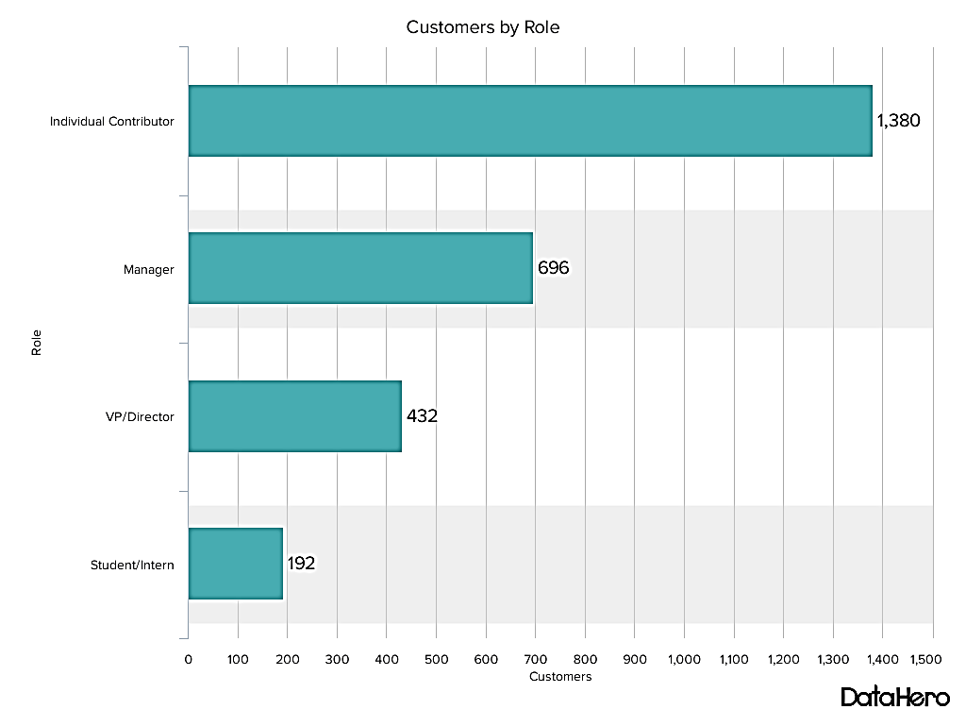
Bar Graph
A bar graph, basically a horizontal column chart, should be used to avoid clutter when one data label is long or if you have more than 10 items to compare.

Slide 12
Design Best Practices for Bar Graphs:
Use consistent colors throughout the chart, selecting accent colors to highlight meaningful data points or changes over time.
Use horizontal labels to improve readability.
Start the x-axis at 0 to appropriately reflect the values in your graph.

Slide 13
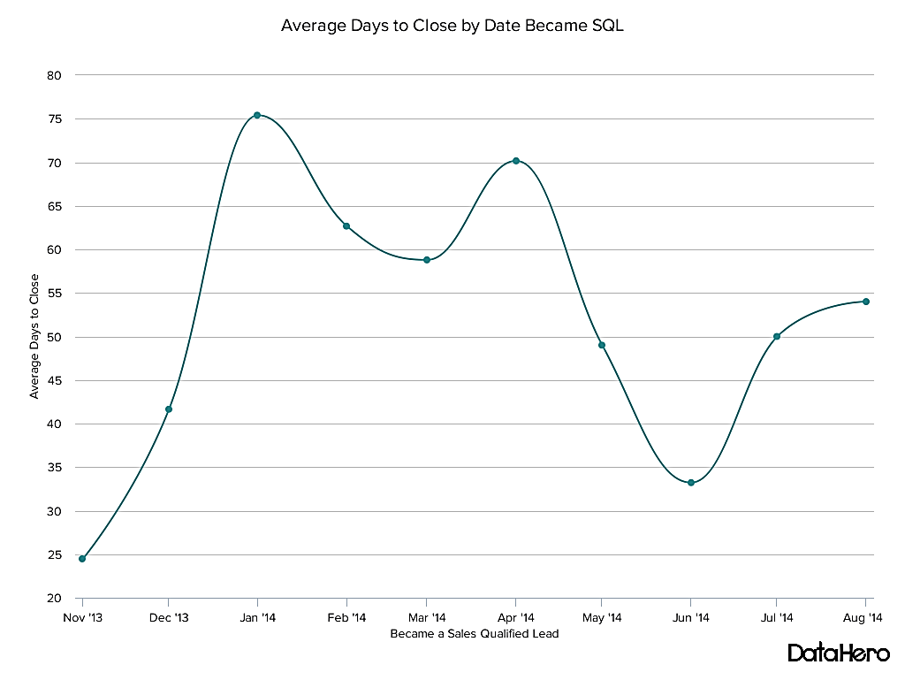
Line Graph
A line graph reveals trends or progress over time and can be used to show many different categories of data. You should use it when you chart a continuous data set.

Slide 14
Design Best Practices for Line Graphs:
Use solid lines only.
Don't plot more than four lines to avoid visual distractions.
Use the right height so the lines take up roughly 2/3 of the y-axis' height.

Slide 15
Dual Axis Chart
A dual axis chart allows you to plot data using two y-axes and a shared x-axis. It's used with three data sets, one of which is based on a continuous set of data and another which is better suited to being grouped by category. This should be used to visualize a correlation or the lack thereof between these three data sets.
Design Best Practices for Dual Axis Charts:
Use the y-axis on the left side for the primary variable because brains are naturally inclined to look left first.
Use different graphing styles to illustrate the two data sets, as illustrated above.
Choose contrasting colors for the two data sets.

Slide 16
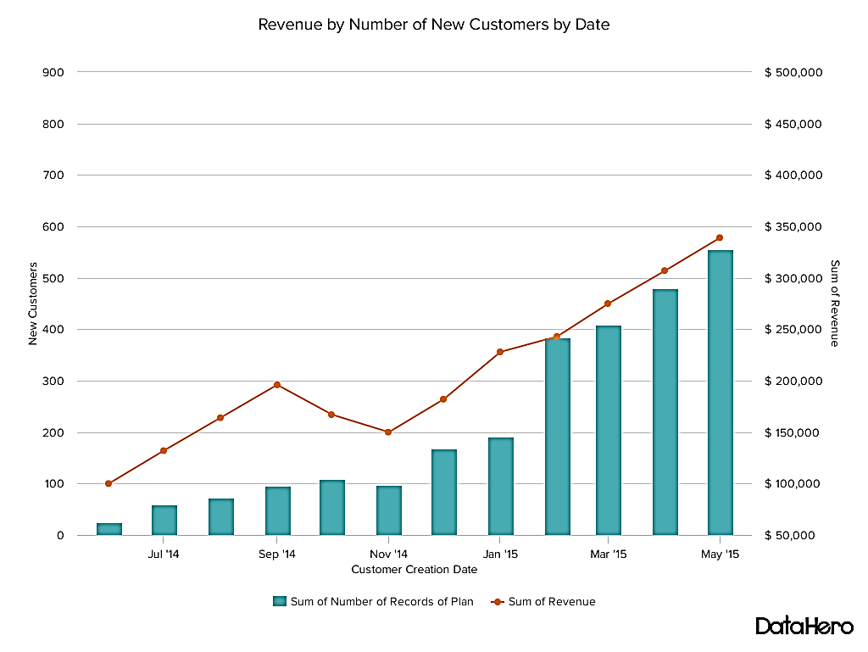

Slide 17
Area Chart
An area chart is basically a line chart, but the space between the x-axis and the line is filled with a color or pattern. It is useful for showing part-to-whole relations, such as showing individual sales reps' contribution to total sales for a year. It helps analyze both overall and individual trend information.
Design Best Practices for Area Charts:
Use transparent colors so information isn't obscured in the background.
Don't display more than four categories to avoid clutter.
Organize highly variable data at the top of the chart to make it easy to read.

Slide 18
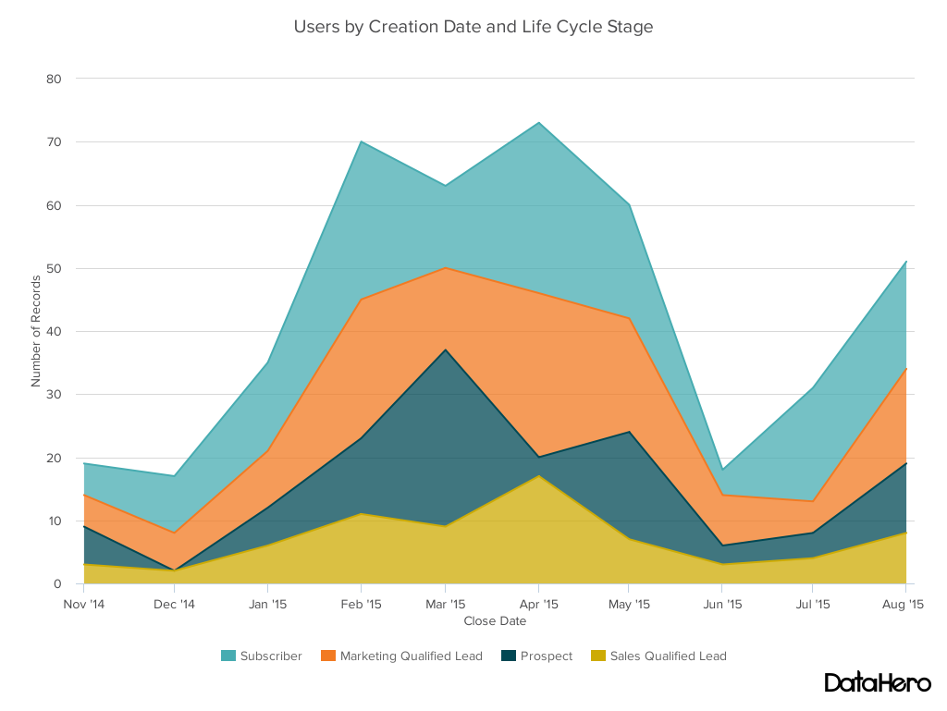

Slide 19
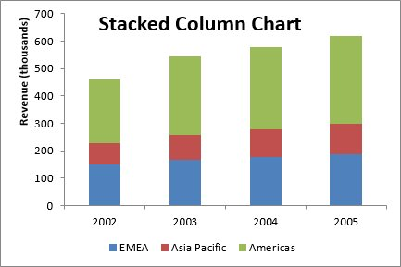
Stacked Bar Chart
This should be used to compare many different items and show the composition of each item being compared.

Slide 20
Design Best Practices for Stacked Bar Graphs:
Best used to illustrate part-to-whole relationships.
Use contrasting colors for greater clarity.
Make chart scale large enough to view group sizes in relation to one another.

Slide 21
Mekko Chart
Also known as a mari mekko chart, this type of graph can compare values, measure each one's composition, and show how your data is distributed across each one.
Design Best Practices for Mekko Charts:
Vary you bar heights if the portion size is an important point of comparison.
Don't include too many composite values within each bar. you might want to reevaluate how to present your data if you have a lot.
Order your bars from left to right in such a way that exposes a relevant trend or message.

Slide 22
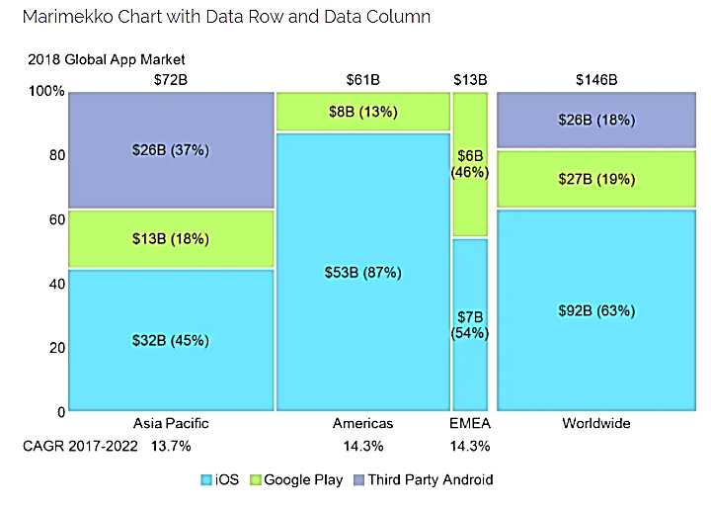

Slide 23
Pie Chart
A pie chart shows a static number and how categories represent part of a whole -- the composition of something. A pie chart represents numbers in percentages, and the total sum of all segments needs to equal 100%.
Design Best Practices for Pie Charts:
Don't illustrate too many categories to ensure differentiation between slices.
Ensure that the slice values add up to 100%.
Order slices according to their size.

Slide 24
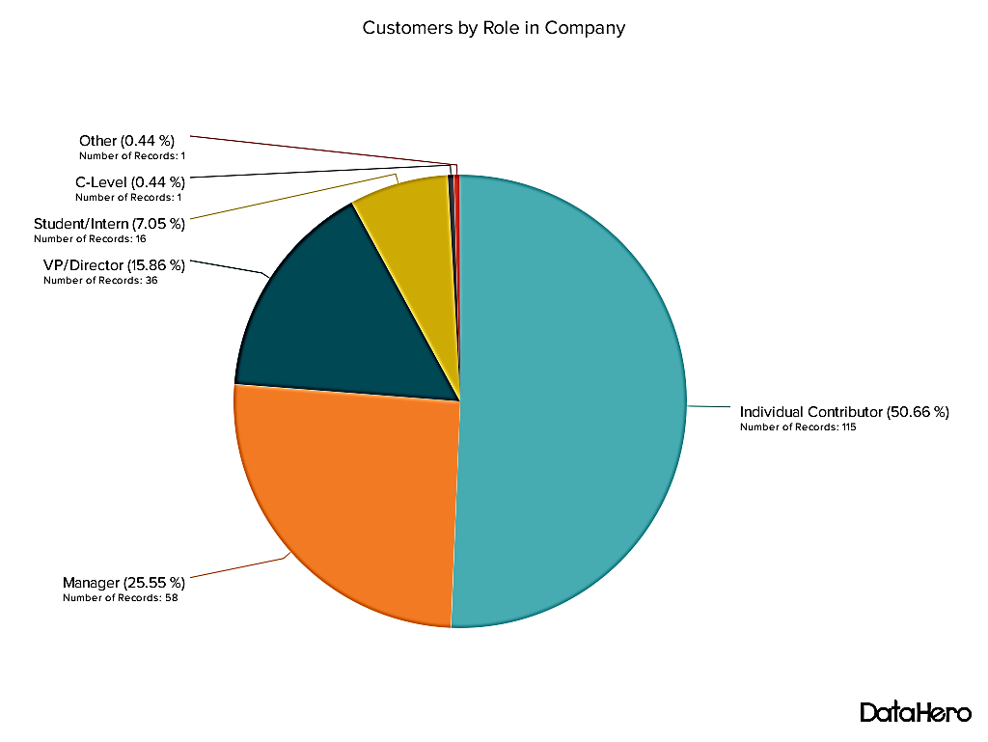

Slide 25
Scatter Plot Chart
A scatter plot or scattergram chart will show the relationship between two different variables or it can reveal the distribution trends. It should be used when there are many different data points, and you want to highlight similarities in the data set. This is useful when looking for outliers or for understanding the distribution of your data.
Design Best Practices for Scatter Plots:
Include more variables, such as different sizes, to incorporate more data.
Start y-axis at 0 to represent data accurately.
If you use trend lines, only use a maximum of two to make your plot easy to understand.

Slide 26
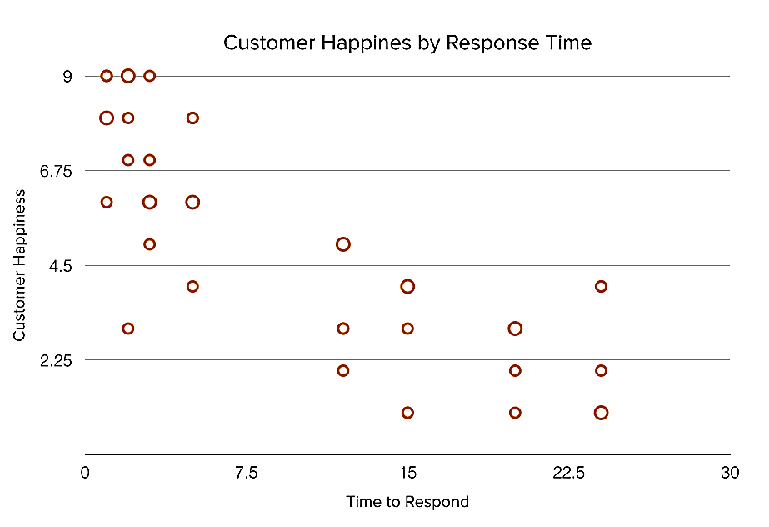

Slide 27
Bubble Chart
A bubble chart is similar to a scatter plot in that it can show distribution or relationship.
Design Best Practices for Bubble Charts:
Scale bubbles according to area, not diameter.
Make sure labels are clear and visible.
Use circular shapes only.

Slide 28
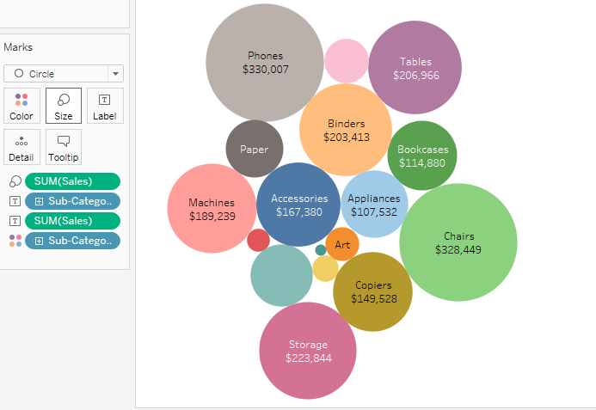

Slide 29
Waterfall Chart
A waterfall chart should be used to show how an initial value is affected by intermediate values -- either positive or negative -- and resulted in a final value. This should be used to reveal the composition of a number. An example of this would be to showcase how overall company revenue is influenced by different departments and leads to a specific profit number.
Design Best Practices for Waterfall Charts:
Use contrasting colors to highlight differences in data sets.
Choose warm colors to indicate increases and cool colors to indicate decreases.

Slide 30
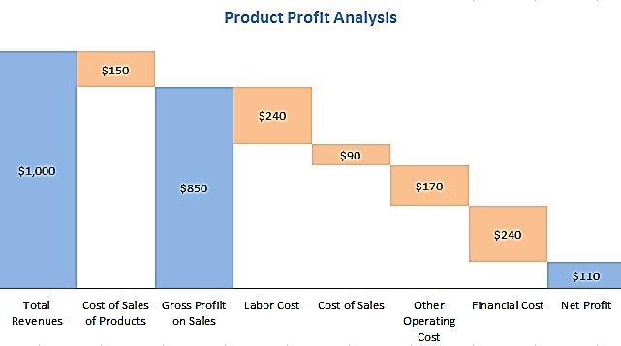

Slide 31
Funnel Chart
A funnel chart shows a series of steps and the completion rate for each step. This can be used to track the sales process or the conversion rate across a series of pages or steps.
Design Best Practices for Funnel Charts:
Scale the size of each section to accurately reflect the size of the data set.
Use contrasting colors or one color in gradating hues, from darkest to lightest as the size of the funnel decreases.

Slide 32
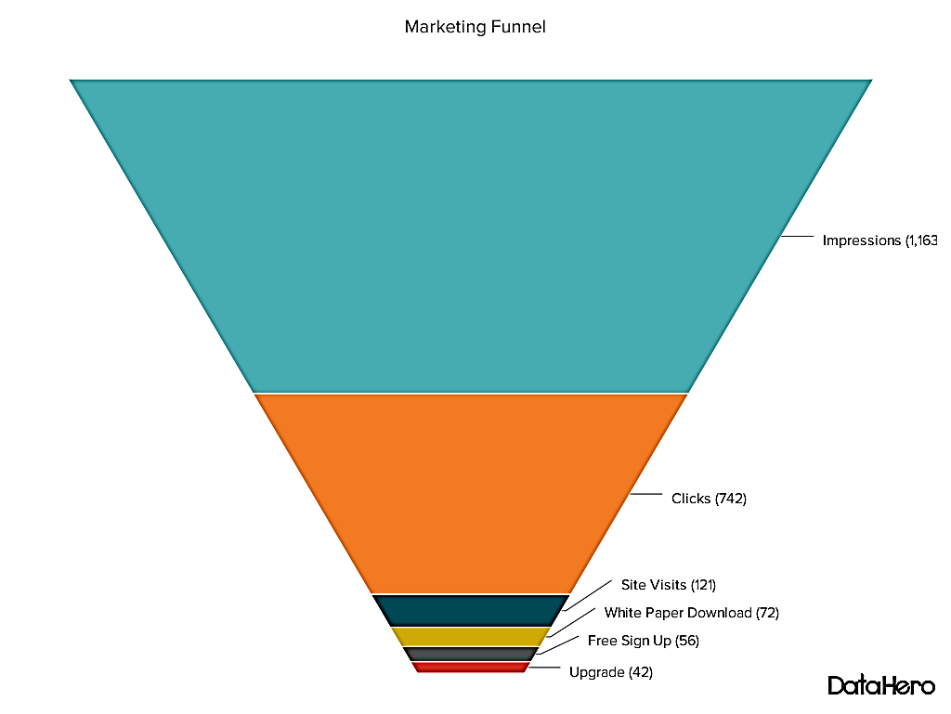

Slide 33
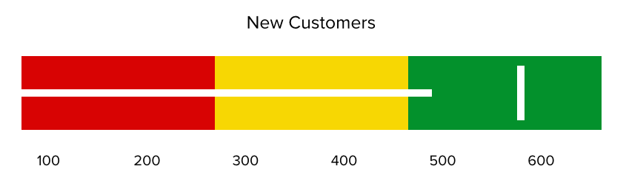
Bullet Graph
A bullet graph reveals progress toward a goal, compares this to another measure, and provides context in the form of a rating or performance.
Design Best Practices for Bullet Graphs:
Use contrasting colors to highlight how the data is progressing.
Use one color in different shades to gauge progress.

Slide 34
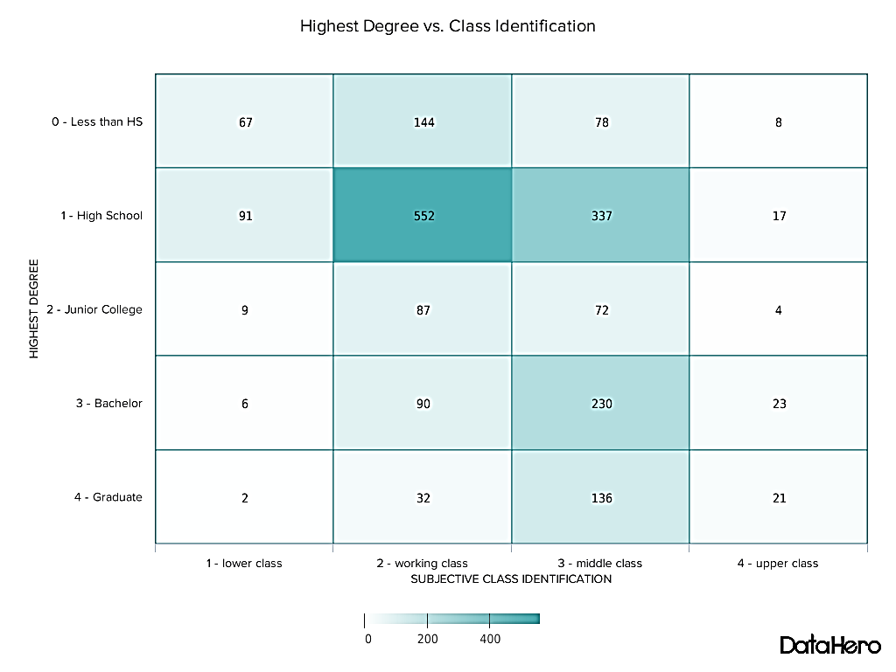
Heat Map
A heat map shows the relationship between two items and provides rating information, such as high to low or poor to excellent. The rating information is displayed using varying colors or saturation.

Slide 35
Design Best Practices for Heat Map:
Use a basic and clear map outline to avoid distracting from the data.
Use a single color in varying shades to show changes in data.
Avoid using multiple patterns.

Slide 36

Text Visualization
Visually representing the content of a text document is one of the most important tasks in the field of text mining. For example, many text visualizations do not represent the text directly, they represent an output of a language model(word count, character length, word sequences, etc.).

Slide 37
Picture Chart
A picture Chart is a pictorial display of data with symbols, icons, and pictures to represent different quantities. The symbols, icons, and pictures of a picture graph typically represent concepts or ideas, or stand in for a larger quantity of something.

Slide 38
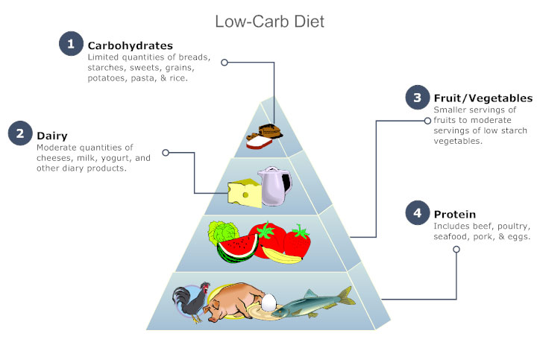
Pyramid Chart
A pyramid chart has the form of a triangle with lines dividing it into sections. A related topic or idea is placed in each section.

Slide 39
Determine a topic. Decide what topic the pyramid will be addressing and place the name at the top of the page.
Choose subcategories. Decide on subcategories for the overall topic that you chose. Be selective when determining the number of subcategories. It will prevent the diagram from appearing too crowded or complicated.
Determine value and status. Organize the subcategories based upon their hierarchy. Whatever form you choose, make sure it is consistent.
Determine status. Make a list of categories and then arrange them from most important to least important, smallest to largest, etc. depending on the hierarchy chosen for the diagram.
Create sections. Divide the pyramid into sections. Since each section will represent one category make sure to arrange them in order, based on the status you chose before.
Label. Write each idea or topic in its corresponding section.

Slide 40
Process chart
The flow process chart is a graphical and symbolic representation of the activities performed on the work piece during the operation
Cycle
Cycle Diagrams are a type of graphic organizer that shows how items are related to one another in a repeating cycle. Use a cycle diagram when there is no beginning and no end to a repeating process.

Slide 41
Hierarchy
A Hierarchy Chart (hierarchical diagram) shows the breakdown of a system to its lowest manageable parts.
Educational purposes
Business purposes

